Slide 1

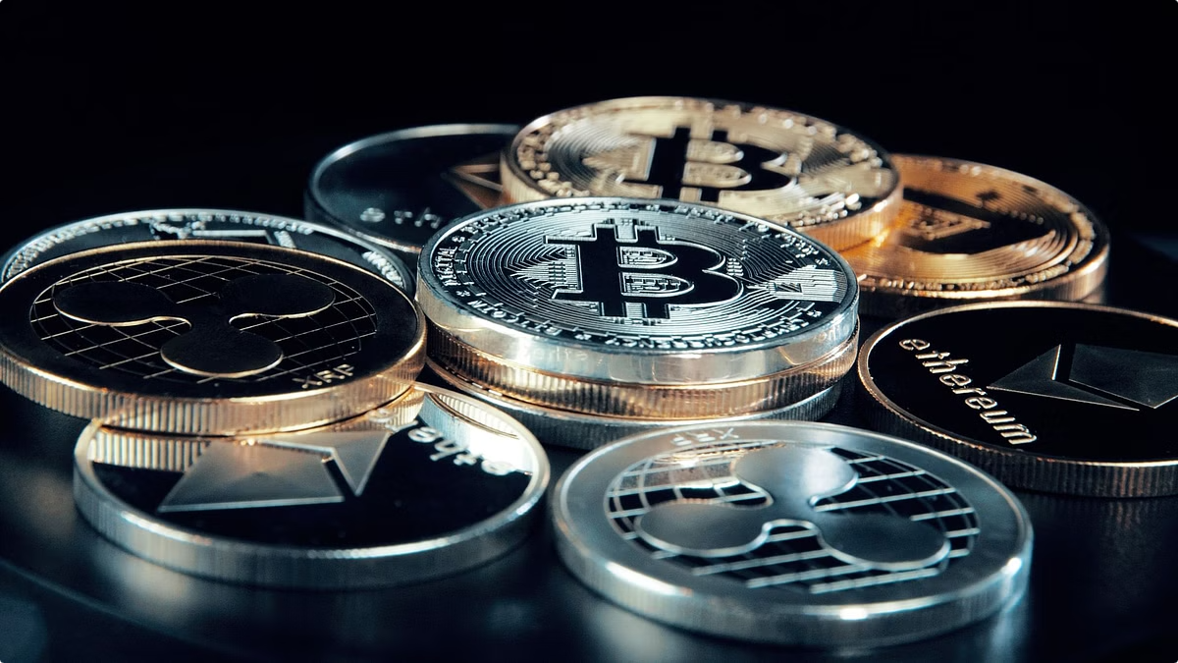
Blockchain Technology: Transforming the Digital Landscape
Blockchain is a revolutionary technology transforming various industries. It is a decentralized, secure, and transparent ledger that records transactions in a secure and permanent manner. It is used in cryptocurrencies, but its applications extend far beyond finance. This presentation explores the fundamentals of blockchain, its applications, and its potential to reshape our digital world.

Slide 2

What is Blockchain?
Distributed Ledger
Decentralized
A shared database distributed across multiple computers, ensuring data integrity and transparency.
No single entity controls the network, promoting trust and eliminating reliance on intermediaries.
Immutable Records
Transactions are recorded chronologically and cannot be altered, providing a permanent and auditable history.

Slide 3
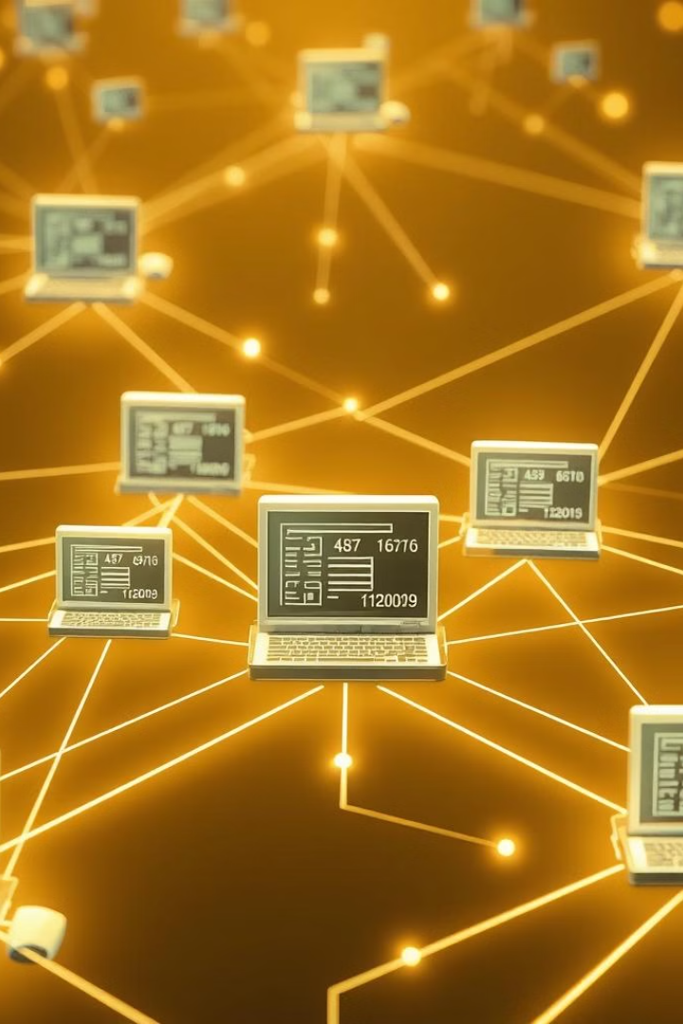




How Does Blockchain Work?
Transaction Request
A transaction is initiated and broadcast to the network.
Verification
Nodes on the network verify the transaction using cryptographic algorithms.
Block Creation
Verified transactions are grouped into blocks and added to the blockchain.
Chain Extension
New blocks are linked to the previous block, forming a chronological chain.

Slide 4

Benefits of Blockchain Technology
1
Security
2
Transparency
The decentralized and encrypted nature of blockchain provides robust security against fraud and tampering.
All transactions are publicly viewable, fostering accountability and trust in the system.
3
Efficiency
Blockchain eliminates intermediaries, streamlining processes and reducing transaction costs.

Slide 5
Applications of Blockchain
Finance
Supply Chain Management
Healthcare
Cryptocurrencies
Product traceability
Secure medical records
Cross-border payments
Inventory management
Drug traceability
Digital identity
Counterfeit prevention
Clinical trials management

Slide 6

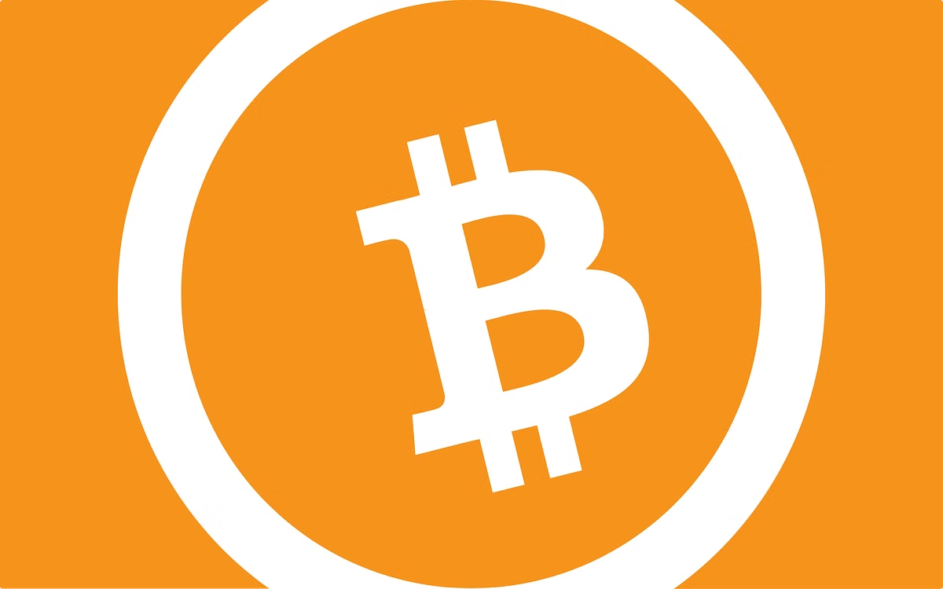
Cryptocurrency and Blockchain
1
Bitcoin
The first and most popular cryptocurrency, operating on a blockchain network.
2
Ethereum
A blockchain platform that supports smart contracts and decentralized applications.
3
Stablecoins
Cryptocurrencies pegged to fiat currencies, offering price stability.

Slide 7
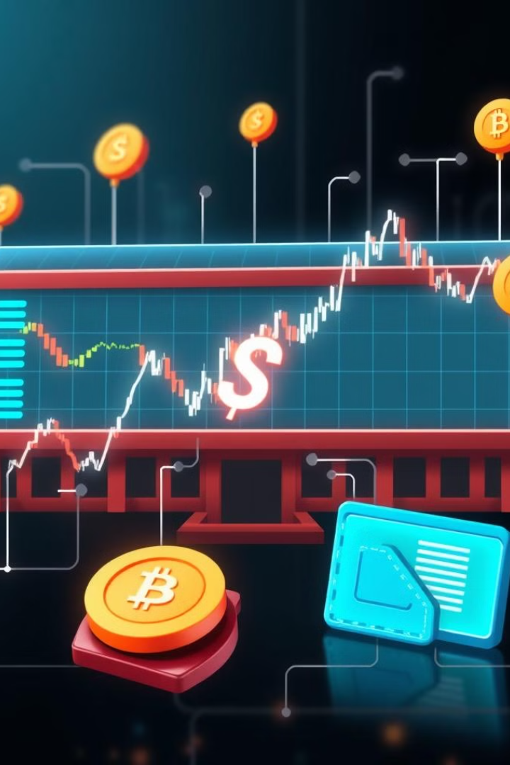



Blockchain in Finance
Faster Payments
Blockchain enables instant and low-cost cross-border transactions.
Increased Security
Blockchain's cryptographic security reduces fraud and minimizes risk.
Enhanced Trust
Transparency and immutability promote trust in financial transactions.

Slide 8
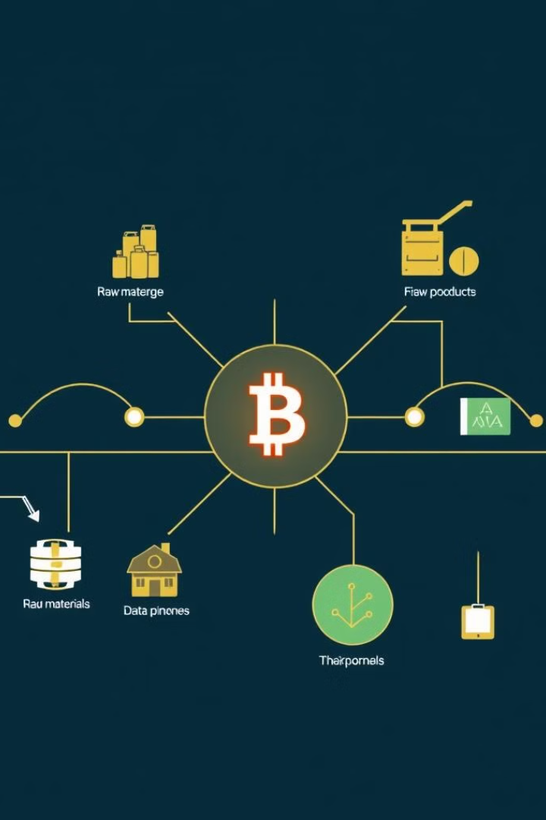
Blockchain in Supply Chain Management
Benefits
Example
Improved Traceability
Tracking the origin and journey of products
Enhanced Transparency
Sharing information securely among stakeholders
Reduced Counterfeiting
Authenticating products and verifying their authenticity

Slide 9
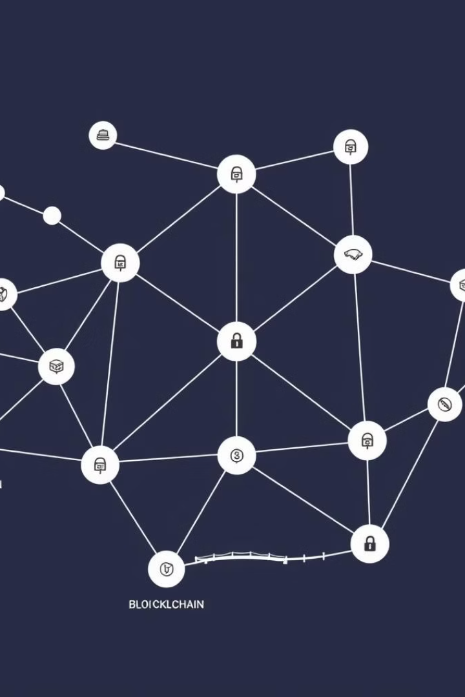
Challenges and Limitations of Blockchain
1
Scalability
2
Regulation
Handling a large volume of transactions can be challenging for some blockchains.
The lack of clear regulations creates uncertainties and hinders wider adoption.
3
Energy Consumption
Some blockchains require significant energy to operate, raising environmental concerns.

Slide 10
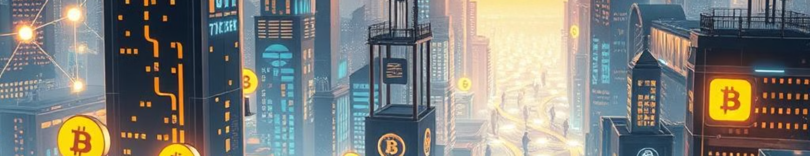
The Future of Blockchain
Blockchain technology is still evolving and its potential applications are vast. As it continues to develop, we can expect to see its impact across various industries, transforming the way we conduct business, manage information, and interact with the digital world.

